Slide 1



Unit Testing
Building Rock-Solid Software
Java OOP
Advanced
SoftUni Team
Technical Trainers
Software University
http://softuni.bg

Slide 2

Table of Contents
What is Unit Testing?
Code and Test vs. Test Driven Development
Unit Testing Frameworks
Unit Testing Best Practices

Slide 3
Questions
sli.do #9762

Slide 4

Unit Testing
Notes:
A unit test is a piece of code written by a developer that exercises a very small, specific area of functionality of the code being tested.
“Program testing can be used to show the presence of bugs but never to show their absence!”
Edsger Dijkstra, [1972]

Slide 5
Unit Testing
Why do we need it?
... relevant to the project we develop
With an eye to future reuse in similar projects
Abstraction helps managing complexity
Notes:
Software unit tests help the developer to verify that the logic of a piece of the program is correct.
Running tests automatically helps to identify software regressions introduced by changes in the source code.
Having a high test coverage of your code allows you to continue developing features without having to perform lots of manual tests.

Slide 6
Unit Testing (2)
How do we do unit tests?
Notes:
There are two types of unit testing:
- Manual
- Using Frameworks

Slide 7

Border cases!

Slide 8

Manual
Notes:
You have already done unit testing - manually, by hand
Manual tests are less efficient
- Not structured
- Not repeatable
- Not on all your code
- Not easy to do as it should be

Slide 9
Example
int sum(Integer... array){ int totalSum = 0; for (int i = 0; i < array.length; i++){ totalSum += array[i]; } return totalSum; }
Notes:
Example of a method, we want to test.

Slide 10
Example (2)
void testSum() { if (sum(1, 2) != 3) throw new TestFailedException("1+2 != 3"); if (sum(-2) != -2) throw new TestFailedException("-2 != -2"); if (sum() != 0) throw new TestFailedException("0 != 0"); }
Notes:
- Tests are specific pieces of code
- In most cases unit tests are written by developers, not by QA engineers
- Unit tests are released into the code repository (TFS / SVN / Git) along with the code they test
All classes should be tested
All methods should be tested
- Trivial code may be omitted
- E.g. property getters and setters
- Private methods can be omitted
Ideally all unit tests should pass before committing in the source control repository
Why should we do Unit Testing ?
- Unit tests dramatically decrease the number of defects in the code
- Unit tests improve design
- Unit tests are good documentation
- Unit tests reduce the cost of change
- Unit tests allow refactoring
- Unit tests decrease the defect-injection rate due to refactoring / changes

Slide 11

Frameworks
Notes:
Unit Testing Frameworks :
- JUnit,
- Arquillian,
- JTest,
- TestNG

Slide 12

Framework
Notes:
Annotations’ Descriptions
@Test public void method()
The @Test annotation identifies a method as a test method.
@Test (expected = Exception.class)
Fails if the method does not throw the named exception.
@Test(timeout=100)
Fails if the method takes longer than 100 milliseconds.
@Before public void method()
This method is executed before each test. It is used to prepare the test environment (e.g., read input data, initialize the class).
@After public void method()
This method is executed after each test. It is used to cleanup the test environment (e.g., delete temporary data, restore defaults). It can also save memory by cleaning up expensive memory structures.
@BeforeClass public static void method()
This method is executed once, before the start of all tests. It is used to perform time intensive activities, for example, to connect to a database. Methods marked with this annotation need to be defined as static to work with JUnit.
@AfterClass public static void method()
This method is executed once, after all tests have been finished. It is used to perform clean-up activities, for example, to disconnect from a database. Methods annotated with this annotation need to be defined as static to work with JUnit.
@Ignore or @Ignore("Why disabled")
Ignores the test method. This is useful when the underlying code has been changed and the test case has not yet been adapted. Or if the execution time of this test is too long to be included. It is best practice to provide the optional description, why the test is disabled.

Slide 13
Testing a Method
String concat(String one, String two ) { return one + two; }
Notes:
A unit test should test a class in isolation. Side effects from other classes or the system should be eliminated if possible.
To eliminate these side effects you have to replace dependencies to other classes.
This can be done via using replacements for the real dependencies.

Slide 14
Example
@Test void concatShouldPass() { // Arrange String expected = "AA"; // Act String actual = concat("A", "A"); // Assert Assert.assertEquals(expected, actual); }
Notes:
The 3A Pattern:
Arrange all necessary preconditions and inputs
Act on the object or method under test
Assert that the expected results have occurred

Slide 15
Testing a Method (2)
String concat(String one, String two) { if (one == null) throw new NullPointerException(); return one + two; }

Slide 16
Example (2)
@Test(expected = ExpectedException.class) void concatShouldThrowException() { // Act String actual = concat(null, "A"); }

Slide 17

Demo

Slide 18
TDD
Test Driven Development
Notes:
Test-driven development (TDD) is a software development process that relies on the repetition of a very short development cycle: requirements are turned into very specific test cases, then the software is improved to pass the new tests, only. This is opposed to software development that allows software to be added that isn't proven to meet requirements.
Kent Beck, who is credited with having developed or 'rediscovered’ the technique, stated in 2003 that TDD encourages simple designs and inspires confidence.
Test-driven development is related to the test-first programming concepts of extreme programming, begun in 1999, but more recently has created more general interest in its own right.

Slide 19
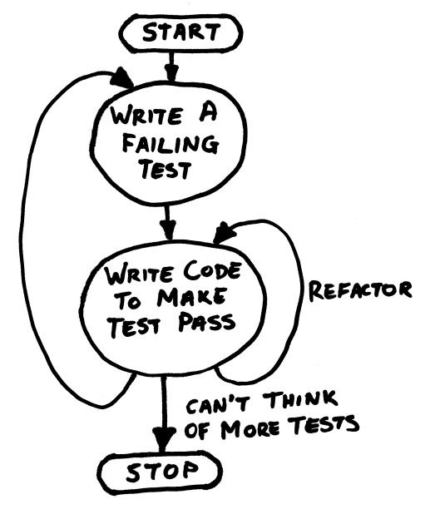
“Test First” Cycle
Notes:
TDD helps find design issues early.
Avoids reworking.
Writing code to satisfy a test is a focused activity.
Less chance of error.
Tests will be more comprehensive than if they are written after the code

Slide 20
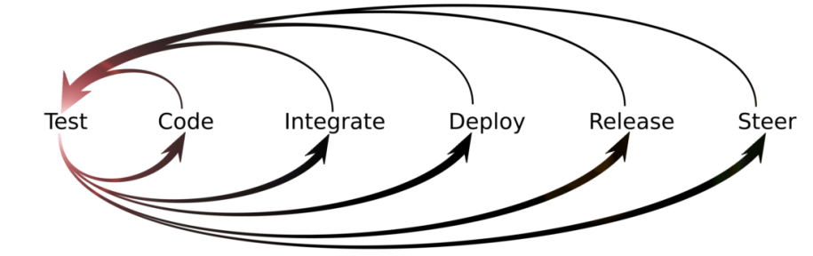
Lifecycle

Slide 21
Demo

Slide 22

Conventions
Notes:
There are several potential naming conventions for JUnit tests. A widely-used solution is to add the suffix "-test" to the names of the test classes and create them in a new package "test".
As a general rule, a test name should explain what the test does. If that is done correctly, reading the actual implementation can be avoided.
One possible convention is to use the word "should" in the test method name. For example, "ordersShouldBeCreated" or "menuShouldGetActive". This gives a hint what should happen if the test method is executed.
If you are using the Maven build system, you should prefer the "Test" suffix over "Tests". The Maven build system (via its surfire plug-in) automatically includes such classes in its test scope.
Generally, a passing test should never be removed.
- These tests make sure that code changes don't break working code.
A passing test should only be changed to make it more readable.
When tests don't pass, it usually means there are conflicting requirements.

Slide 23
Conventions
Notes:
TDD approach. Create your test case before anything else.
Avoid writing test cases that can cause impact
Never skip tests
Sensible Test Case names!
Create Order Implementation
Create Order Test Case
Always aim to do one assertion for each test method
Assertions, maximize it!
The JUnit Assert package has a lot of methods that can be used to do test cases. Combine this with a hamcrest and you get an extremely powerful api that uses pattern matching utilities.
Test code is separated from Production / release code
Make use of @Before, @After – Never construct the test case class
Don’t just pass the test just for the sake of passing it!
Do not write your own catch blocks that exist only to pass a test
Do not write your own catch blocks that exist only to print a stack trace
Avoid the Threads sa much as possible
Maven or Gradle – Build tools to automate
Test Case Coverage and report using surefire plugin
The 80% test coverage rule
Mock your data!
The General Tip: Keep tests small and fast

Slide 24

Exercises in Class

Slide 25

Mocking
Notes:
A dummy object is passed around but never used, i.e., its methods are never called. Such an object can for example be used to fill the parameter list of a method.
Fake objects have working implementations, but are usually simplified. For example, they use an in memory database and not a real database.
A stub class is an partial implementation for an interface or class with the purpose of using an instance of this stub class during testing. Stubs usually do responding at all to anything outside what’s programmed in for the test. Stubs may also record information about calls
A mock object is a dummy implementation for an interface or a class in which you define the output of certain method calls.
Test doubles can be passed to other objects which are tested. Your tests can validate that the class reacts correctly during tests. For example, you can validate if certain methods on the mock object were called. This helps to ensure that you only test the class while running tests and that your tests are not affected by any side effects.
Mock objects are typically configured. Mock objects typically require less code to configure and should therefore be preferred.

Slide 26
Mocking
Why do we need it?
... relevant to the project we develop
With an eye to future reuse in similar projects
Abstraction helps managing complexity
Notes:
A unit test should test a class in isolation. Side effects from other classes or the system should be eliminated if possible. To eliminate these side effects you have to replace dependencies to other classes. This can be done via using replacements for the real dependencies.

Slide 27
Mocking (2)
How do we do mocking?
Notes:
There are two approaches:
- Manual
- Using Frameworks

Slide 28
Example
public class FakeHtmlProvider implements HtmlProvider { public String DownloadHtml(String pageUrl) { String fakeHtml = "<html>" + "<img src=\"nakov.png\"/>" + "<span>Hello</span>" + "<img src=\"courses/inner/background.jpeg\"/>" + "</html>"; return fakeHtml; } }
Notes:
Manually mocked object

Slide 29
Frameworks
Notes:
Mockking Frameworks :
- Mockito,
- PowerMock (extension to support, mocking private and static methods, final classes),
- EasyMock,
- jmockit

Slide 30

Mockito
Notes:
Annotations’ Descriptions
@Mock - mocks a class or interface
@Spy - partial mocking, real methods are invoked but still can be verified and stubbed.
@InjectMocks - marks a field on which, Mockito will try to inject mocks only either by constructor injection, setter injection, or property injection.
@Captor - capture what arguments where called

Slide 31
Example
@Mock private List<String> list;
@Test public void testIsMockedShouldPass() { list.add("one"); Mockito.verify(list).add("one"); assertEquals(0, list.size()); when(list.size()).thenReturn(100); assertEquals(list.size(), 100); }

Slide 32
Example (2)
@Mock private BufferedReader reader; @Test public void testMockingShouldPass() throws IOException { // Arrange String expected = "Hello"; when(reader.readLine()).thenReturn("Hello"); // Act String actual = reader.readLine(); // Assert Assert.assertEquals(expected, actual); }

Slide 33
Example (3)
public class CharAppend { private Reader reader; public CharAppend(Reader reader) { this.reader = reader; } public String append(char argument) throws IOException { return (char) this.reader.read() + Character.toString(argument); } }

Slide 34
Example (4)
@Mock private Reader readerMock; @Test public void testAppendShouldPass() throws IOException { // Arrange Mockito.when(this.readerMock.read()).thenReturn(65); CharAppend charApp = new CharAppend(this.readerMock); String expected = "AB"; // Act String actual = charApp.append('B'); // Assert Assert.assertEquals(expected, actual); }

Slide 35
Demo

Slide 36

Summary
Unit Testing
Code First
Test First
Mocking

Slide 37









Unit Testing
https://softuni.bg/java-advanced-oop

Slide 38

License
This course (slides, examples, demos, videos, homework, etc.) is licensed under the "Creative Commons Attribution-NonCommercial-ShareAlike 4.0 International" license
Attribution: this work may contain portions from
"Fundamentals of Computer Programming with Java" book by Svetlin Nakov & Co. under CC-BY-SA license
"OOP" course by Telerik Academy under CC-BY-NC-SA license

Slide 39






Free Trainings @ Software University
Software University Foundation – softuni.org
Software University – High-Quality Education, Profession and Job for Software Developers
softuni.bg
Software University @ Facebook
facebook.com/SoftwareUniversity
Software University @ YouTube
youtube.com/SoftwareUniversity
Software University Forums – forum.softuni.bg

